Slide 1
A3: apache spark
Tutorial

Slide 2
Overview
To learn concepts of Big Data Systems running on Clouds
To learn data analysis, warehousing and distributed database on real time data
To learn Real-Time Data Pipelines using Apache Spark
To learn Cloud technology supporting Big Data applications

Slide 3
Introduction to apache spark
Apache Spark was developed in the AMPLab at U.C. Berkeley in 2009.
It has become one of the key big data distributed processing frameworks in the world.
Spark’s in-memory data engine means that it can perform tasks at high speed.
Provides native bindings for the Java, Scala, Python, and R.
Supports SQL, streaming data, machine learning, and graph processing.

Slide 4
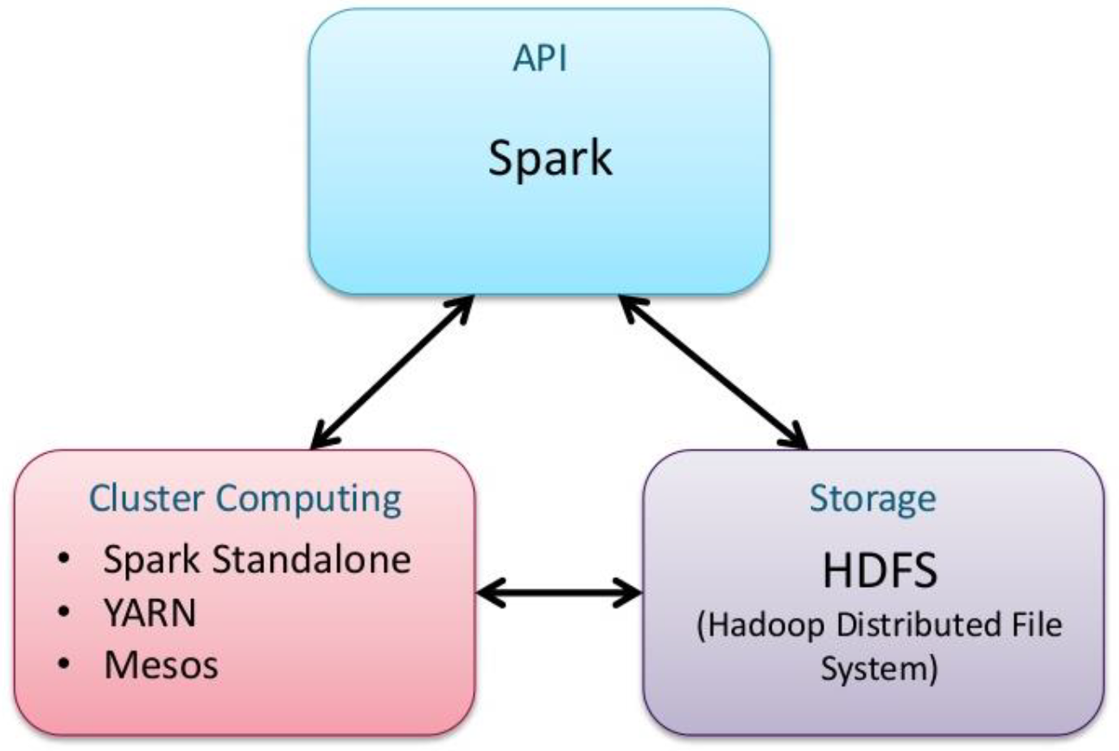
Distributed processing

Slide 5

Spark cluster mode
Driver is the entry point to Spark shell
SparkContext is created in driver and enables driver to interact with resource manager
Driver schedules tasks and control execution
Driver handles metadata and split DAG (Directed Acyclic Graph) for operations on data

Slide 6
Sparkcontext
from pyspark import SparkContext, SparkConf
# appName: name for your app to show on the cluster UI
# master: URL for Spark, Mesos or YARN cluster, or “local”
# string to run in local mode
conf = SparkConf().setAppName(appName).setMaster(master)
# Create SparkContext to tell Spark how to access the
# cluster
sc = SparkContext(conf=conf)

Slide 7
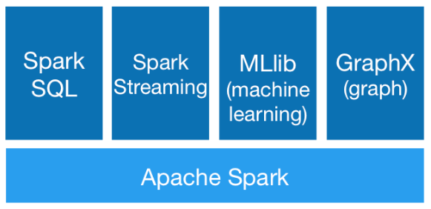
Spark components
SparkSQL: Support for structured and semi-structured data
Spark Streaming: Analytics on streaming data eg. Kafka, Flume
Mlib: Packages for Machine Learning
GraphX: Distributed graph processing framework

Slide 8
Resilient distributed datasets (rdd)
Fault-tolerant collection of elements that can be operated on in parallel.
Fundamental data unit in Spark.
Resilient: Immutable and partitioned , rebuilt on failure
Distributed: stored in memory across cluster nodes
Dataset: can hold data from different sources. Held in memory or cached to storage
Operations:
Transformations
Actions

Slide 9
transformations
Create a new dataset from an existing one.
Lazy - they do not compute their results right away
Executed when actions are run on it
Transformation | Description
map(func) | Return a new distributed dataset formed by passing each element of the source through a function func.
filter(func) | Return a new dataset formed by selecting those elements of the source on which func returns true.
distinct([numTasks]) | Return a new dataset that contains the distinct elements of the source dataset.
flatMap(func) | Similar to map, but each input item can be mapped to 0 or more output items (so func should return a seq rather than a single item).

Slide 10
actions
Actions return values from Dataset
Action | Description
reduce(func) | Aggregate the elements of the dataset using a function func (which takes two arguments and returns one). The function should be commutative and associative so that it can be computed correctly in parallel.
collect() | Return all the elements of the dataset as an array at the driver program. This is usually useful after a filter or other operation that returns a sufficiently small subset of the data.
count() | Return the number of elements in the dataset.
first() | Return the first element of the dataset (similar to take(1)).

Slide 11
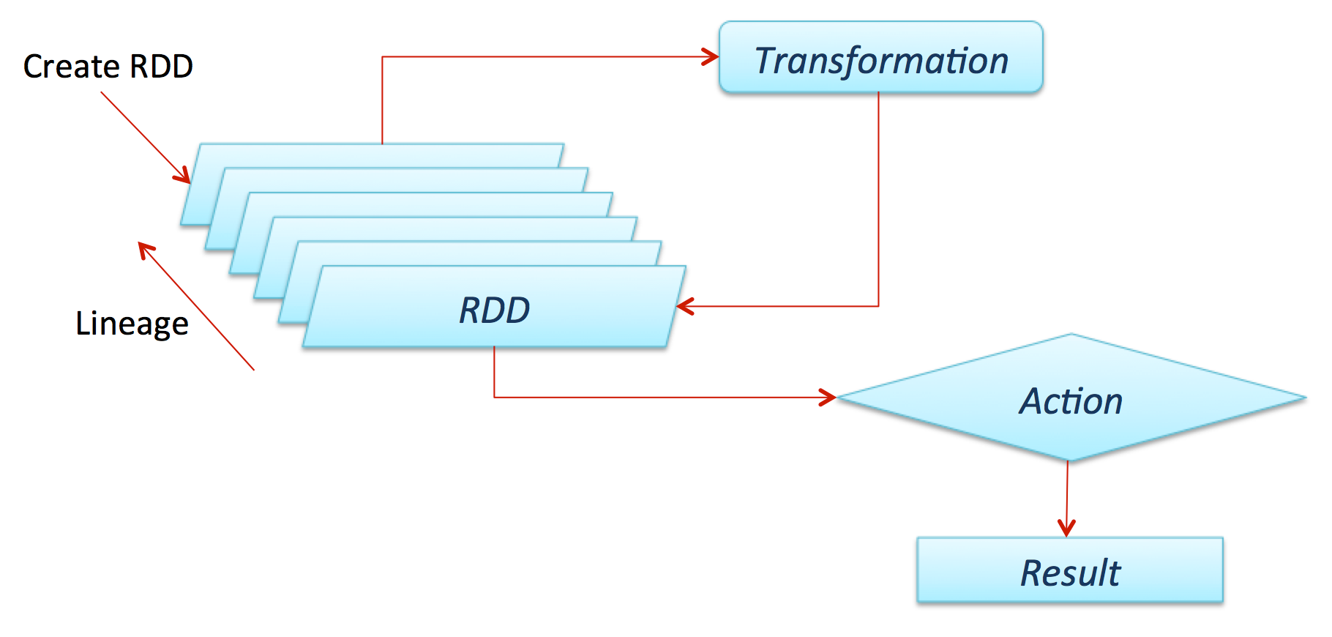
rdd
Actions return values from Dataset

Slide 12
Assignment 3 tasks

Slide 13
Prerequisites
Create new EC2 instance and install Java as in A1, with Inbound ports 8080 and 8081 enabled.
Create a new account on Twitter (twitter.com) or use existing that you created for A2.
Installed python 2 or python 3

Slide 14
Install Apache spark on ec2

Slide 15
Install OPEN JDK (alternative to oracle jdk)
Install open jdk:
sudo apt-get -y install openjdk-8-jdk-headless

Slide 16
Download spark
Create a new folder:
mkdir ~/server
cd ~/server
Download Apache Spark:
wget http://apache.mirror.rafal.ca/spark/spark-2.3.0/spark-2.3.0-bin-hadoop2.7.tgz
or
curl -L http://apache.mirror.rafal.ca/spark/spark-2.3.0/spark-2.3.0-bin-hadoop2.7.tgz > spark-2.3.0-bin-hadoop2.7.tgz
and unpack:
sudo tar zxvf spark-2.3.0-bin-hadoop2.7.tgz

Slide 17
Path setup
You need to export JAVA_HOME:
export JAVA_HOME=/usr/lib/jvm/java-8-openjdk-amd64/
Export SPARK_HOME:
export SPARK_HOME=~/server/spark-2.3.0-bin-hadoop2.7
If you want to use python 3 with Spark then:
export PYSPARK_PYTHON=python3

Slide 18
Extra: Permanent Environment Var in ubuntu
Open ~/.profile file:
sudo nano ~/.profile
Append following to the file:
export JAVA_HOME=/usr/lib/jvm/java-8-openjdk-amd64/
export SPARK_HOME=~/server/spark-2.3.0-bin-hadoop2.7
export PYSPARK_PYTHON=python3
Restart the session

Slide 19
Startup master
The master is in charge of the cluster. This is where you submit jobs, and this where you go for the status of the cluster.
Start the master as follows:
cd ~/server
sudo ./spark-2.3.0-bin-hadoop2.7/sbin/start-master.sh

Slide 20
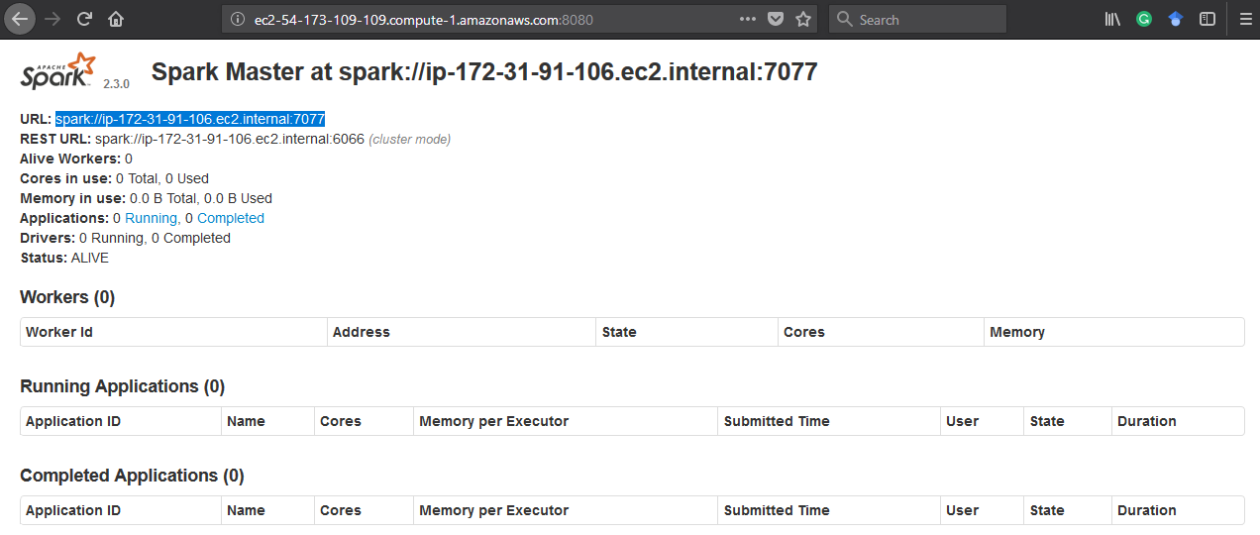
Startup master

Slide 21
Startup slave
Ensure that JAVA_HOME is set properly.
Run the following command:
sudo ./spark-2.3.0-bin-hadoop2.7/sbin/start-slave.sh spark://<your-ec2-internal-ip-or-hostname>:7077

Slide 22
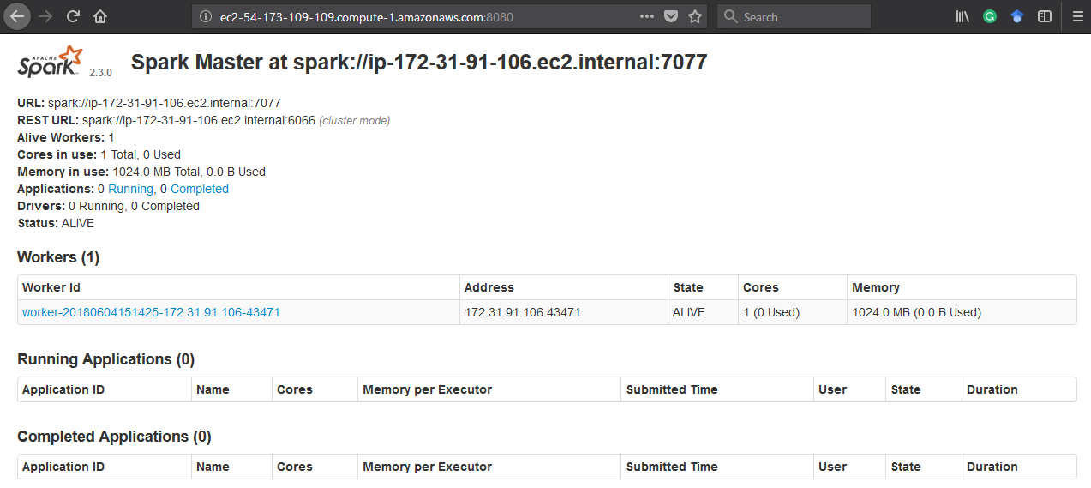
Startup SLAVE

Slide 23
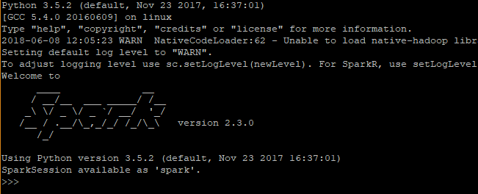
Run simple job on apache spark
Now start the session with master:
$SPARK_HOME/bin/pyspark --master spark://ip-172-31-91-106.ec2.internal:7077

Slide 24
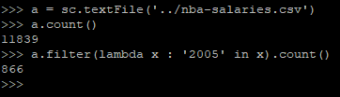
Run simple job on apache spark
Example:
>>> a = sc.textFile(‘../nba-salaries.csv')
>>> a.count()
11839
>>> a.filter(lambda x : '2005' in x).count()
866

Slide 25
Run simple job on apache spark
Same example, just through python script:
from pyspark import SparkContext
dataFile = "nba-salaries.csv"
sc = SparkContext("spark://ip-<your-ip>.ec2.internal:7077", "Simple App")
a = sc.textFile(dataFile)
print ("Count of records: ", a.count())
print ("Count of 2005 records: ", a.filter(lambda x : '2005' in x).count())
sc.stop()
And submit a job:
$SPARK_HOME/bin/spark-submit nba-salaries.py

Slide 26
Spark streaming from twitter

Slide 27
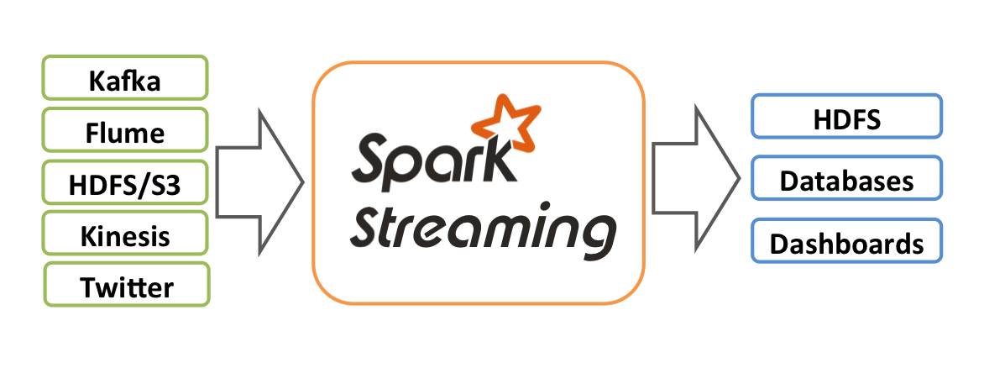
Spark streaming api
Perfect for live dashboards, pushing live data to databases, filesystems.
Also great for machine learning and graph processing algorithms on data streams.

Slide 28
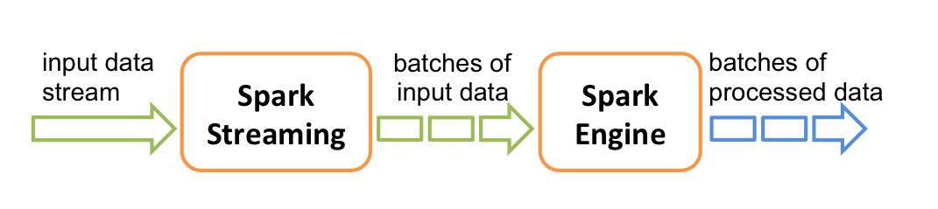
Spark streaming FLOW
Live input data streams
Divides the data into batches
Spark engine processes the batches
Generates the final stream of results in batches

Slide 29
SPARK STREAMING WITH PYTHON
Create Tweepy StreamListener
Publish through internal socket
Create Spark socketTextStream
Connect to local socket and stream tweets

Slide 30
TWEEPY STREAM LISTENER
class YourListener(tweepy.StreamListener):
""" A listener handles tweets are the received from the stream. """
def on_status(self, status):
tweet = self.get_tweet(status)
print( ' '.join(tweet) )
self.client_socket.send( json.dump(tweet) )
return True
# Twitter error list : https://dev.twitter.com/overview/api/response-codes
def on_error(self, status_code):
if status_code == 403:
print("The request is understood, but the access is not allowed. Limit may be reached.")
return False

Slide 31
Publish through a socket
import socket
# Local connection
host = “<type_in_ip>” # Get local ip (private address from EC2).
port = 5555 # Reserve a port for your service.
s = socket.socket() # Create a socket object.
s.bind((host, port)) # Bind to the port.
print("Listening on port: %s" % str(port))
s.listen(5) # Now wait for client connection.
c, addr = s.accept() # Establish connection with client.
print("Received request from: " + str(addr))

Slide 32
CREATE stream listener on spark side
from pyspark import SparkContext
from pyspark.streaming import StreamingContext
sc = SparkContext("local[2]", "Tweet Streaming App")
ssc = StreamingContext(sc, 10)
# Making checkpoints in case spark fails to process the data
ssc.checkpoint( "file:/home/ubuntu/tweets/checkpoint/")
# Local IP of the tweepy streamer socket
socket_stream = ssc.socketTextStream(“<type_in_ip>", 5555)
# Streaming in batches
lines = socket_stream.window(20)

Slide 33
Working with stream data
# Number of tweets in the batch
lines.count().map(lambda x:'Tweets in this batch: %s' % x).pprint()
words = lines.flatMap( lambda twit: twit.split(" ") )
# If we want to filter hashtags only, add filter to words
# filtered = words.filter( lambda word: word.lower().startswith("#") )
pairs = words.map( lambda word: ( word.lower(), 1 ) )
wordCounts = pairs.reduceByKey( lambda a, b: a + b )
wordCounts.pprint()
# Start streaming
ssc.start()
ssc.awaitTermination()

Slide 34
RUNNING
To run the tweepy listener, run it in the background:
python3 tweepy_stream.py &
Then run Spark Stream receiver:
$SPARK_HOME/bin/spark-submit spark_stream_listener.py

Slide 35
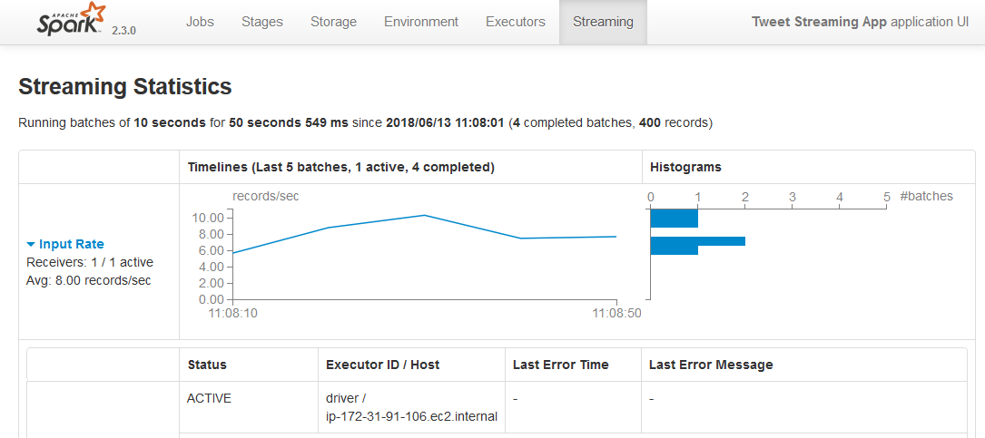
SPARK UI
On ec2 instance open 4040 inbound port
Go to public ec2 ip on port 4040 through your browser:

Slide 36
Spark machine learning

Slide 37

How machine learns?
Start with assumption about solution for given problem
Make machine go over data to verify the assumption
Repeat previous step many times
Measure error, and improve accordingly
Once the assumption doesn’t change, stop

Slide 38
Machine Learning and big data
Machine Learning | Big Data
Optimized for iterative computations | Optimized for single pass computations
Maintains state between stages | Stateless
CPU intensive | Data intensive
Vector/Matrix based | Single row/column at the time

Slide 39
Machine Learning with spark
Spark is first general purpose big data processing engine
The initial design of Spark was driven by machine learning optimization:
Cashing,
Accumulation,
CPU intensive tasks with lazy execution.

Slide 40
MLIB api
Spark comes with a good set of ML algorithms for:
feature extraction,
selection,
transformation,
algorithms for classification,
regression,
clustering and more.
All this can be combined into pipelines,

Slide 41
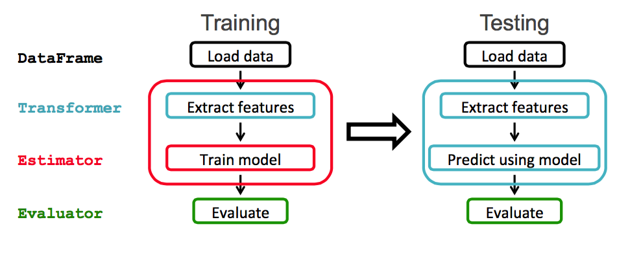
How PIPELINES work?

Slide 42
Feature extractors
Spark offers three ways of extracting the data:
CountVectorizer
(term frequency vectors)
TF-IDF
(term freq – inverse term freq vectors)
Word2vec
(vector based representation of words using cosine distance, relatively new approach)

Slide 43
Feature extractors - example
from pyspark.ml.feature import CountVectorizer
# Input data: Each row is a bag of words with a ID.
df = spark.createDataFrame([
(0, "a b c".split(" ")),
(1, "a b b c a".split(" "))
], ["id", "words"])
# fit a CountVectorizerModel from the corpus.
cv = CountVectorizer(inputCol="words", outputCol="features", vocabSize=3, minDF=2.0)
model = cv.fit(df)
result = model.transform(df)

Slide 44
Feature Transformers
Spark offers a relatively big set of transformer tools, and they are very easy to use:
Tokenizer
StopWordRemover
N-grams
Binarizer
PCA
…
Take a look at docs for more https://spark.apache.org/docs/2.3.0/ml-features.html

Slide 45
Feature Transformers – example 1
from pyspark.ml.feature import Tokenize
from pyspark.sql.functions import col, udf
from pyspark.sql.types import IntegerType
sentenceDataFrame = spark.createDataFrame([
(0, "Hi I heard about Spark"),
(1, "I wish Java could use case classes"),
(2, "Logistic,regression,models,are,neat")
], ["id", "sentence"])
tokenizer = Tokenizer(inputCol="sentence", outputCol="words")
countTokens = udf(lambda words: len(words), IntegerType())
tokenized = tokenizer.transform(sentenceDataFrame)
tokenized.select("sentence", "words") \
withColumn("tokens", countTokens(col("words"))).show(truncate=False)

Slide 46
Feature Transformers – example 2
from pyspark.ml.feature import NGram
wordDataFrame = spark.createDataFrame([
(0, ["Hi", "I", "heard", "about", "Spark"]),
(1, ["I", "wish", "Java", "could", "use", "case", "classes"]),
(2, ["Logistic", "regression", "models", "are", "neat"])
], ["id", "words"])
ngram = NGram(n=2, inputCol="words", outputCol="ngrams")
ngramDataFrame = ngram.transform(wordDataFrame)
ngramDataFrame.select("ngrams").show(truncate=False)

Slide 47
Feature SELECTOR
from pyspark.ml.feature import ChiSqSelector
from pyspark.ml.linalg import Vectors
df = spark.createDataFrame([
(7, Vectors.dense([0.0, 0.0, 18.0, 1.0]), 1.0,),
(8, Vectors.dense([0.0, 1.0, 12.0, 0.0]), 0.0,),
(9, Vectors.dense([1.0, 0.0, 15.0, 0.1]), 0.0,)], ["id", "features", "clicked"])
selector = ChiSqSelector(numTopFeatures=1, featuresCol="features",
outputCol="selectedFeatures", labelCol="clicked")
result = selector.fit(df).transform(df)
print("ChiSqSelector output with top %d features selected" % selector.getNumTopFeatures())
result.show()

Slide 48
estimators
Classification
LogisticRegression,
Decision Trees,
Random Forest,
Naïve Bayes,
Multilayer Perceptron,
SVM (support vector machines)
Regression
Clustering

Slide 49
Estimators - Example
from pyspark.ml.classification import LogisticRegression
# Load training data
training = spark.read.format("libsvm").load("data.txt")
lr = LogisticRegression(maxIter=10, regParam=0.3, elasticNetParam=0.8)
# Fit the model
lrModel = lr.fit(training)

Slide 50
Pipeline – put all together
from pyspark.ml import Pipeline
from pyspark.ml.classification import LogisticRegression
from pyspark.ml.feature import Tokenizer
# Prepare training documents from a list of (id, text, label) tuples.
training = spark.createDataFrame([
(0, "a b c d e spark", 1.0),
(1, "b d", 0.0),
(2, "spark f g h", 1.0),
(3, "hadoop mapreduce", 0.0)
], ["id", "text", "label"])
# Configure an ML pipeline, which consists of two stages: tokenizer and lr.
tokenizer = Tokenizer(inputCol="text", outputCol="words")
lr = LogisticRegression(maxIter=10, regParam=0.001)
pipeline = Pipeline(stages=[tokenizer, lr])
# Fit the pipeline to training documents.
model = pipeline.fit(training)

Slide 51
evaluators
from pyspark.ml.evaluation import BinaryClassificationEvaluator, MulticlassClassificationEvaluator
# Evaluate, metricName=[accuracy | f1 | auc ]default f1 measure
evaluator = BinaryClassificationEvaluator
(rawPredictionCol="prediction",labelCol="label")
print("F1: %g" % (evaluator.evaluate(predictions)))

Slide 52
Saving and loading fitted model
# save the trained model for future use
pipelineFit.save("logreg.model")
# Loading data
from pyspark.ml import PipelineModel
PipelineModel.load("logreg.model")

Slide 53
Spark SQL and dataframes

Slide 54
DATASETS and dataframes
Dataset is a distributed collection of data.
It provides the benefits of RDDs (strong typing, ability to use powerful lambda functions)
And the benefits of Spark SQL’s optimized execution engine.
DataFrame is a Dataset organized into named columns (like a table in RDB).

Slide 55
Spark sql
Intended for processing structured data
Utilizes Spark DataFrames
Load and process data from several different sources eg. JSON, Hive tables, Cassandra, MySql etc.
SQLContext/SparkSession: Entry point for Spark

Slide 56
Useful references
Training dataset link:
http://help.sentiment140.com/for-students/
Twitter API docs:
https://developer.twitter.com/en/docs
Apache Spark docs:
https://spark.apache.org/docs/2.3.0/
Spark SQL:
https://spark.apache.org/docs/latest/sql-programming-guide.html#sql

